Slide 1
Secure Copier (Secure Pen drive Copier)
Faculty Guide
Mr. RAJA.R
Team Members
1. ARAVINDHAN.S
2. MYTHREYAN.R
3. NAVEEN.D
4. ARUN.C.V
Industrial Guide
Mr. Prakash Bagsariya (Persistent Company)
Mr. Saurabh Samanta (BEL)
Department of CSE, KGiSL Institute of Technology, Coimbatore

Slide 2
Abstract
Secure copier is a software/ tool which allows the transfer of data between the authorized devices with user’s confirmation. An virtual hard disk is introduced in order to encrypt the data automatically and to make it as a secured data storage. Only the authorized machines will be able to read the virtual hard disk on the mass storage device, to access the data. In case of, unauthorized access in authorized system, the tool will format the mass storage device automatically.
Department of CSE, KGiSL Institute of Technology, Coimbatore

Slide 3
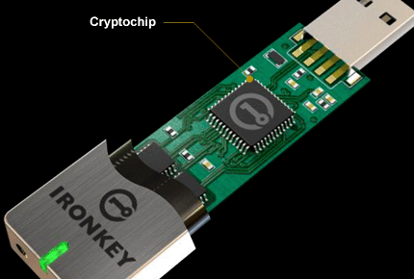
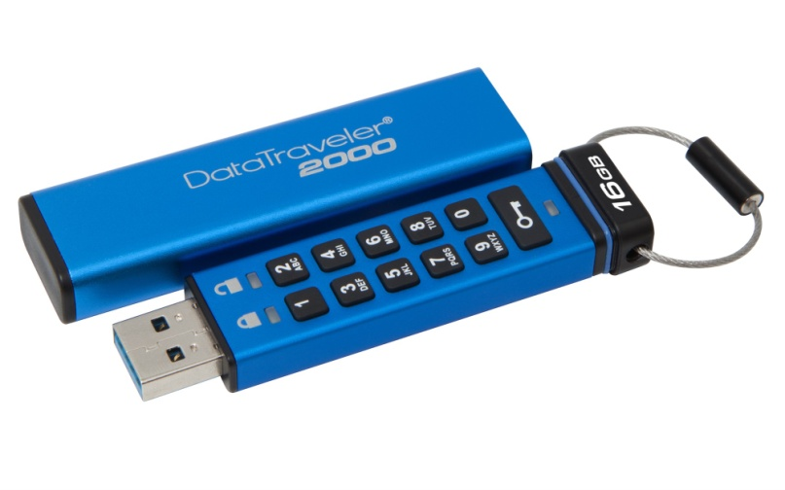
Area Introduction-Existing system
There are some existing protected USB flash drive:
IRONKEY
Cryptochip (for authentication)
Auto-format
Expensive than DataTraveler (nearly lakhs)
DATA TRAVELER
Alphanumeric keypad
Full-disk AES 256-bit hardware
based encryption
Most expensive (nearly 15000)
Department of CSE, KGiSL Institute of Technology, Coimbatore

Slide 4
Proposed System
In this project, the large amount of confidential data will be transferred securely. Only the authorized person can access the data. This project is mainly to prevent data from unauthorized access.
Advantage over existing methods
No need to depend on particular pen drive or mass storage device.
Each file will be transferred with user confirmation.
Stronger Authorization.
Future Enhancements
Secure Copier will be designed to work on multiple operating systems.
Authorized pen drive will be defined with the virtual hard disk.
In order to read or write into the device, the system needs secure copier software.
If the unauthorized pen drive is connected in authorized system, the tool will format
the device automatically.
Department of CSE, KGiSL Institute of Technology, Coimbatore

Slide 5
Literature Review
Drawbacks of existing methods
If the password is known, the data can be accessed.
Dependency of exact product.
Most expensive product.
Low Security.
References
https://www.kingston.com/en/usb/encrypted_security/dt2000
https://www.kingston.com/datasheets/DT2000_en.pdf
https://www.kingston.com/en/usb/encrypted_security/IKS1000
https://www.kingston.com/datasheets/IKS1000_en.pdf
Department of CSE, KGiSL Institute of Technology, Coimbatore

Slide 6
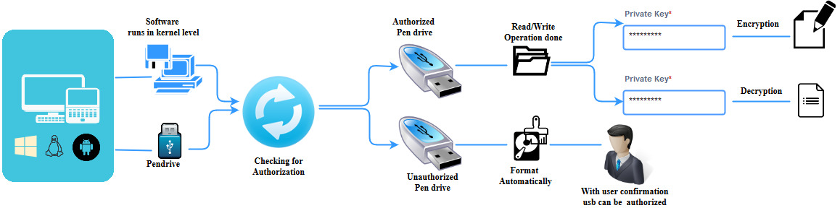
Architectural Design

Slide 7
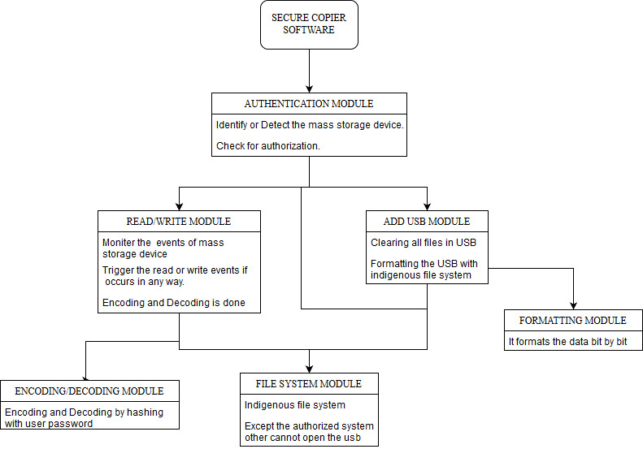
Module wise development plan or Process Flow Diagram

Slide 8
Module Splitup
Module 1 : Authentication Module
Identify or Detect the mass storage device
Check for Authorization
Module 2 : Read or Write Module
Monitor the events of USB
Trigger the read or write events if occurs
Module 3 : Data Security
Encryption & Decryption
Module 4: Virtual Hard Disk
Creating Virtual Hard disk
Module 5: Add USB Module
Clearing all files in USB
Formatting the USB with indigenous file system
Department of CSE, KGiSL Institute of Technology, Coimbatore

Slide 9
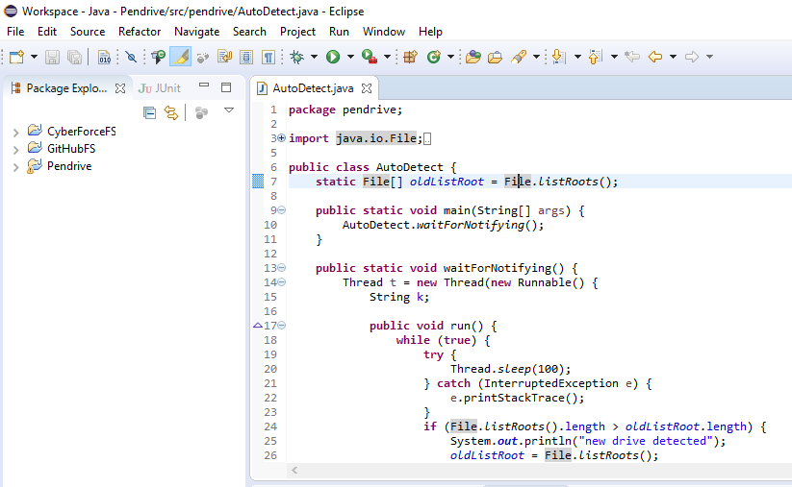
Module 1 : Authentication Module
Coding snippet :

Slide 10
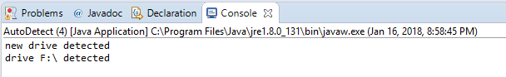
Output :

Slide 11
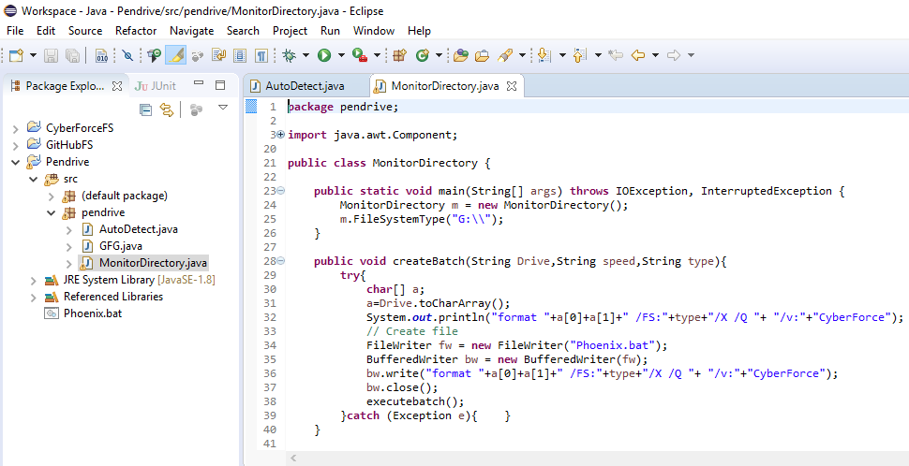
Module 2 : Read or Write Module
Coding snippet :

Slide 12
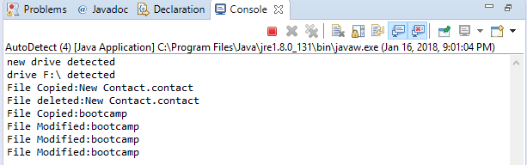
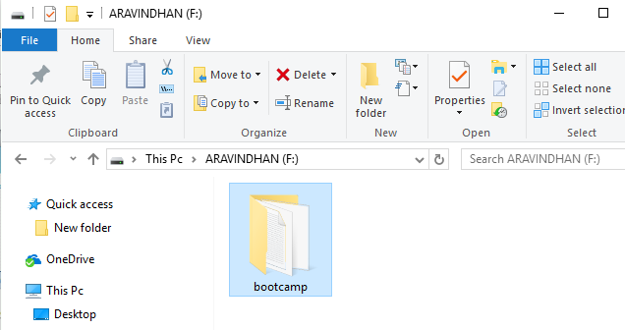
Output :

Slide 13
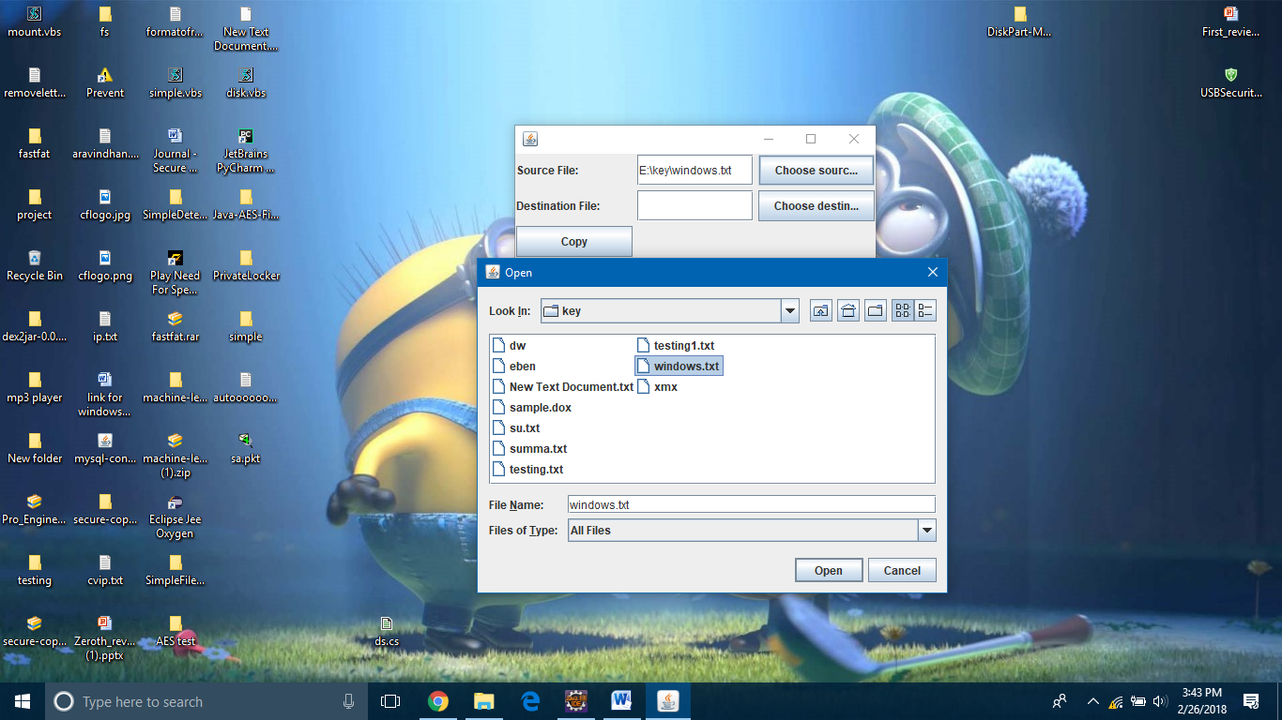
Module 2 : Read or Write Module (Cont.)

Slide 14
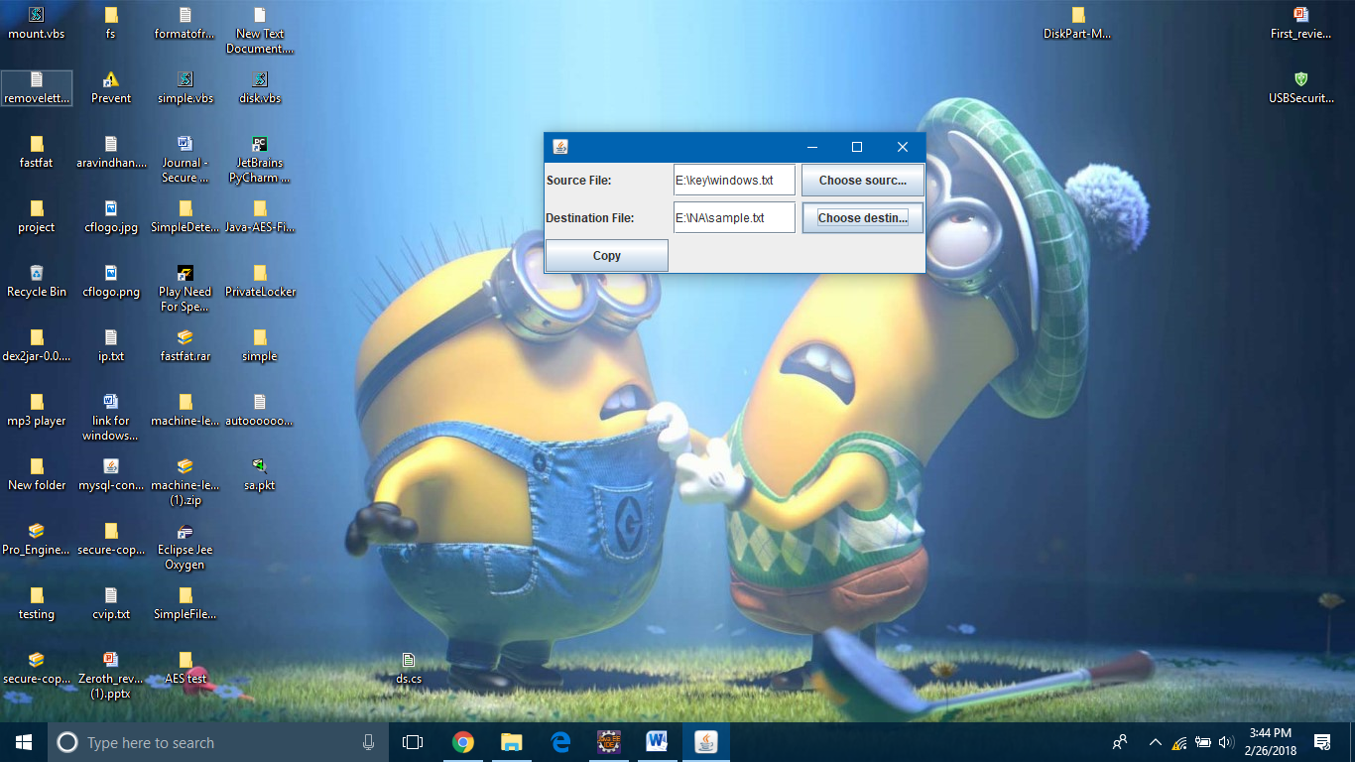

Slide 15
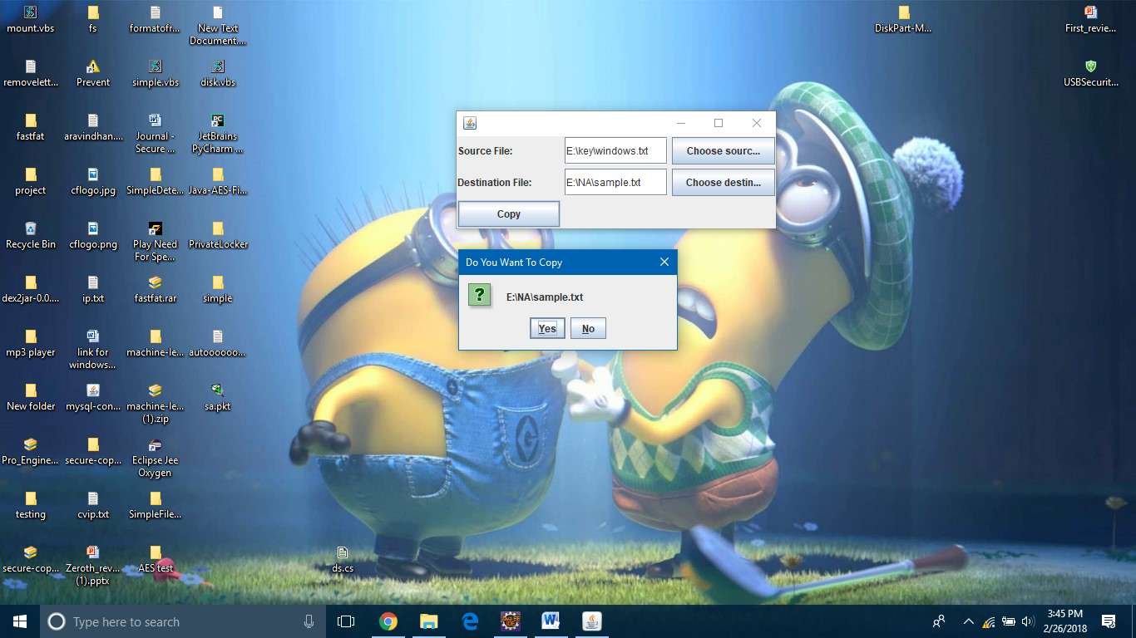

Slide 16
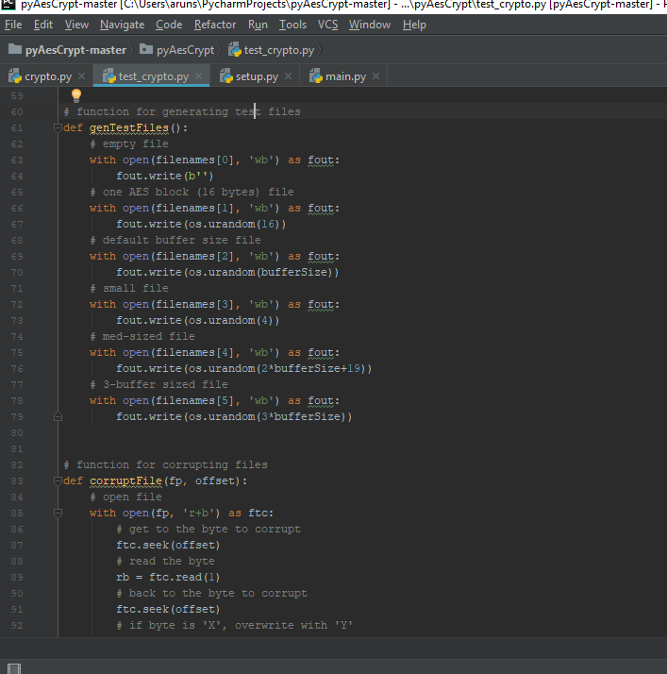
Module 3 : Data Security

Slide 17
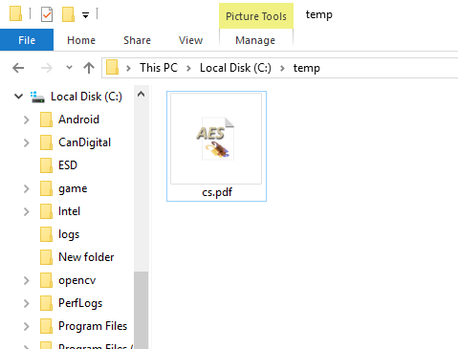
Encrypted File :

Slide 18
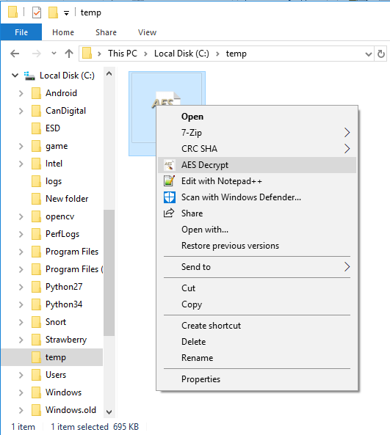
Decryption :

Slide 19
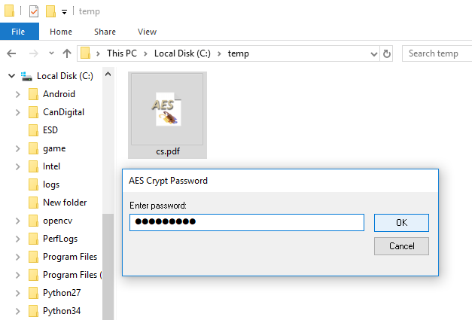
Decryption :

Slide 20
Project Planner
Gantt chart
Department of CSE, KGiSL Institute of Technology, Coimbatore

Slide 21
Project Planner / Timeline (Gantt chart)
Particulars | Dec-17 |  |  |  | Jan-18 |  |  |  | FEb-18 |  |  |  | Mar-18 |  |  |  | April
 | Wk 1 | Wk 2 | Wk 3 | Wk 4 | Wk 1 | Wk 2 | Wk 3 | Wk 4 | Wk 1 | Wk 2 | Wk 3 | Wk 4 | Wk 1 | Wk 2 | Wk 3 | Wk 4 | Wk 1
Problem Identification
Literature Survey
Module 1
Module 2
Module 3
Module 4 & 5
Thesis Draft
Final Thesis
Viva
Department of CSE, KGiSL Institute of Technology, Coimbatore

